Slide 1
SAP HANA Data Provisioning

Slide 2
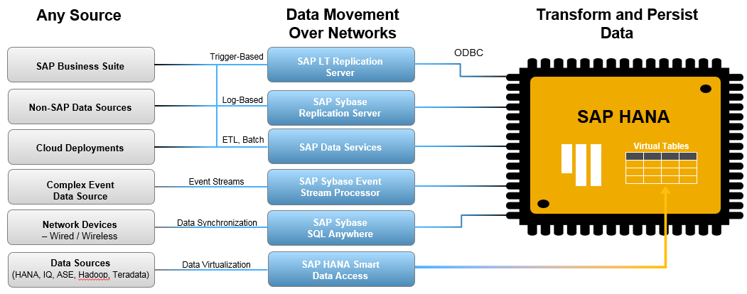
SAP HANA Scenarios Real-time high volume data integration from any source

Slide 3
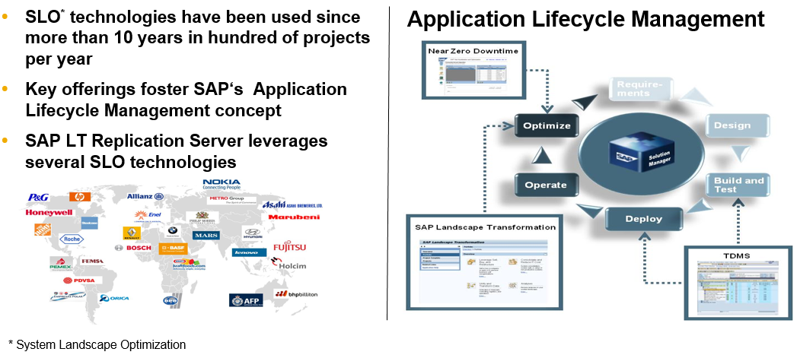
SAP LT Replication Server Leverages Proven SLO Technologies

Slide 4
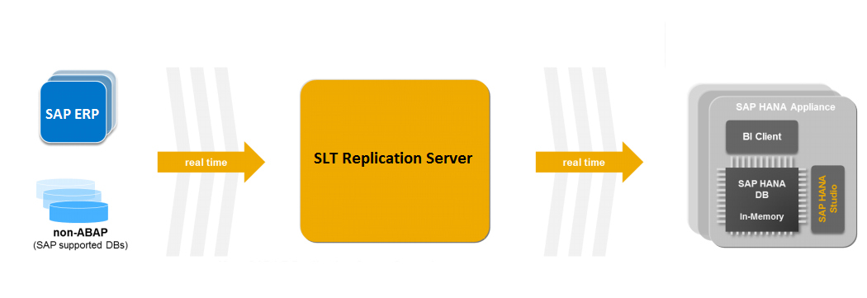
What is SLT?
One of the main features of HANA is that, it can provide real time data to the customer at any point of time. This is made possible with the help of SLT (SAP Landscape Transformation) where real time data is loaded to HANA from SAP or Non-SAP source systems.
SAP Landscape Transformation Replication Server (“SLT”)
is for all SAP HANA customers who need real-time or scheduled data replication, sourcing from SAP and NON-SAP sources
Uses trigger-based technology to transfer the data from any source to SAP HANA in real-time.
SLT server can be installed on the separate
system or on SAP ECC System.
Replication can be triggered Real-time
or scheduled

Slide 5
SLT Benefits
Benefit of SLT system
Allows real-time or schedule time data replication. SLT handles Cluster and Pool tables.
This is fully integrated with SAP HANA Studio. SLT have table setting and transformation capabilities.
SLT have monitoring capabilities with SAP HANA Solution Manager.
During replicating data in real-time, we can migrate data in SAP HANA Format.
SLT Architecture overview between SAP System and SAP HANA
SLT Replication Server transforms all metadata table definitions from the ABAP source system to SAP HANA.
For SAP source, the SLT connection has the following features -
If your source system is SAP then you can install SLT as separate system or in Source itself.
When a table is replicated, SLT Replication server create logging tables in the source system.
The connection between SLT and SAP Source is established as RFC connection.
The connection between SLT and SAP HANA is established as a DB connection.
If you install SLT in Source system itself, then we no more need to have an RFC Connection
Network
Replicating data is a business process with significant network requirements that depends on the actual throughput (T) and the weighted average length (WL) of record in bytes. You can calculate the network bandwidth by using the following formula:
Network Bandwidth [Mbit/s] = 8 * WL * T [records/second] / 1000000
The performance of SAP LT Replication Server solution benefits from a network bandwidth of 1 GB or higher.

Slide 6
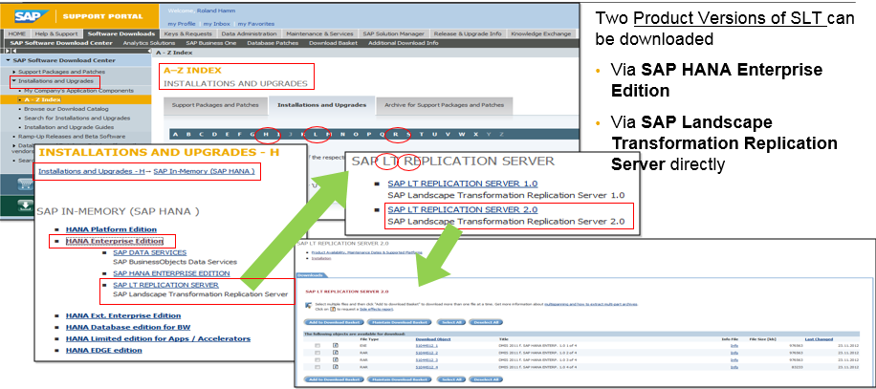
New Software Download Access path in https://service.sap.com/SWDC (Installation & Upgrade)

Slide 7
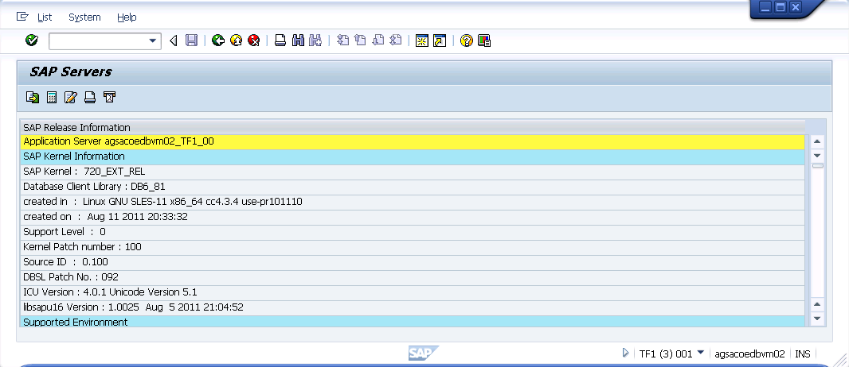
SAP Kernel and DBSL Installation
Install required SAP kernel and DBSL on SAP LT Replication Server
Upgrade kernel as per Note 1597627
7.20 Kernel with PL >= 110
7.20 DBSL with PL >= 100 is needed
Install HANA DB-Client SW on SLT system as per Note 1597627
#./hdbinst -a client -p /usr/sap/TF1/hdbclient -s TF1
Add hdb client libraries to library path, e.g. by adding the following line to .sapenv_<host>.csh setenv LD_LIBRARY_PATH ${LD_LIBRARY_PATH}:/usr/sap/<SID>/hdbclient

Slide 8
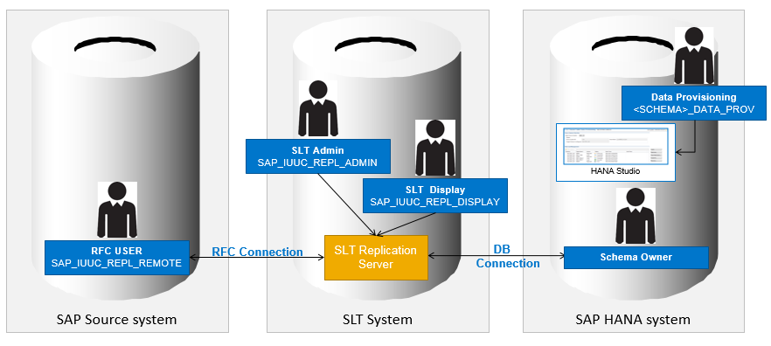
SAP LT Replication Server Authority Concept

Slide 9
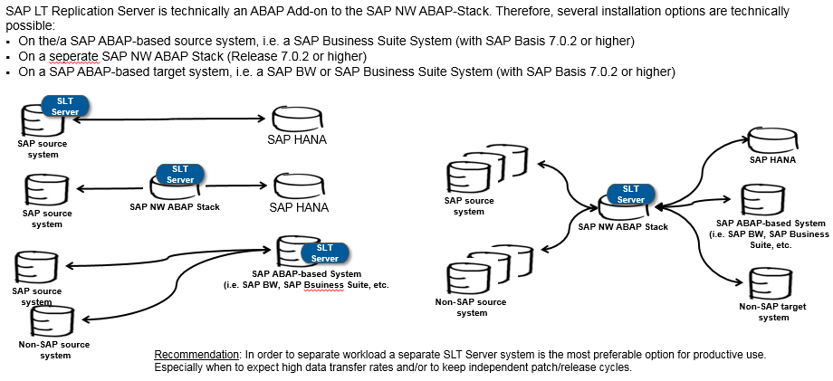
SAP LT Replication Server Installation options

Slide 10
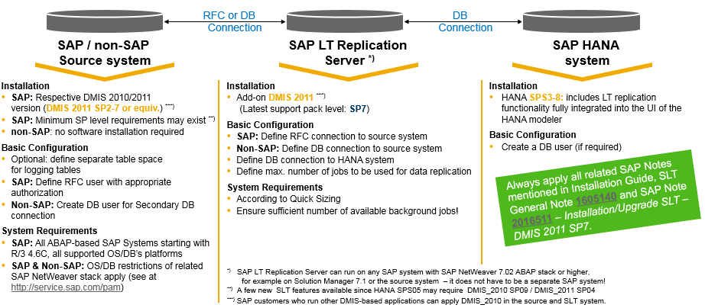
Technical Prerequisites and System Set-Up Information

Slide 11
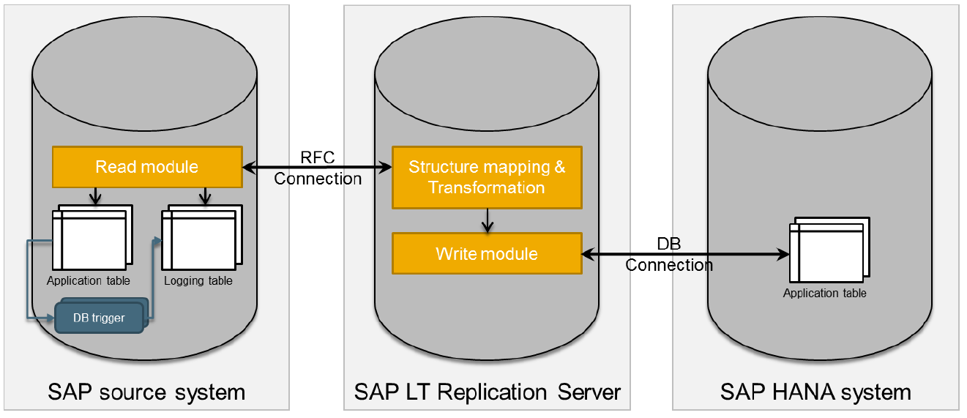
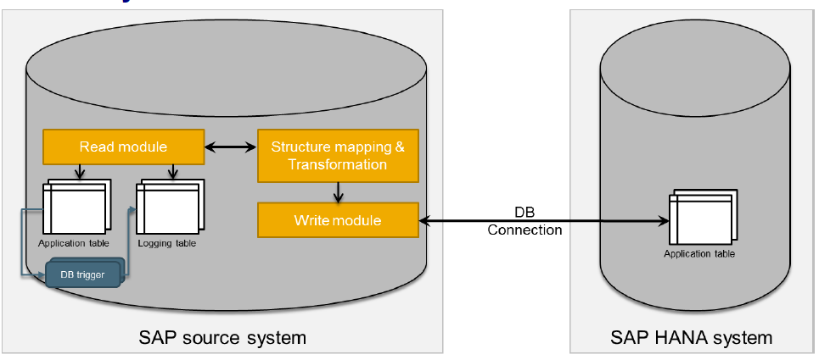
SLT Replication Process
SLT Server automatically create DB connection for SAP HANA database (when we create a new configuration via transaction LTR). There is no need to create it manually.
The SAP Note (1605140) provides complete information
to install SLT system. In case SLT Replication Server is
installed in the Source System the architecture will be
as shown below

Slide 12
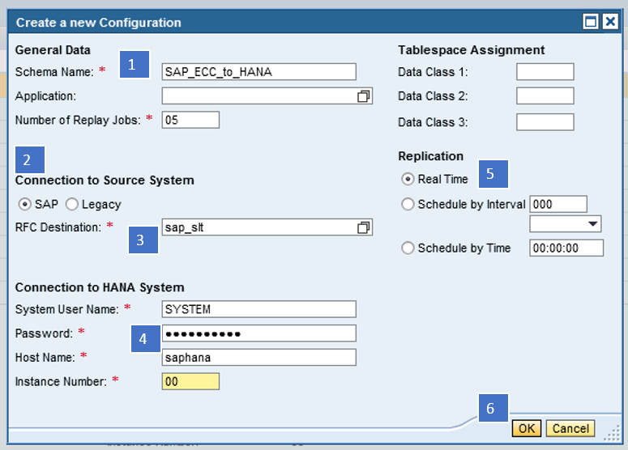
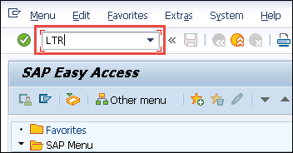
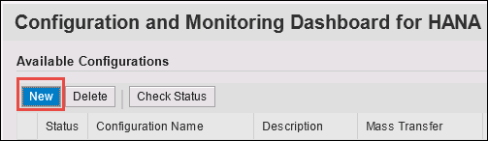
How to replicate data from SAP Source to HANA using SLT
In order to replicate data from SAP source system to HANA, two major steps are involved.
Configure SAP SLT Server for SAP Source System
Import SAP Source Data to SAP HANA through SLT

Slide 13
Import SAP Source Data to SAP HANA through SLT
Once we had successfully created our schema in SLT (Source system), we will observe that a schema with the same name will be created in SAP HANA studio, which has 8 tables under it along with 2 stored procedures, 4 roles and a privilege.
Once our schema is created, we can go ahead and replicate source system tables into our HANA database.
The tables that are created are
DD02L
DD02T
DD08L
RS_LOG_FILES
RS_MESSAGES
RS_ORDER
RS_ORDER_EXT
RS_SCHEMA_MAP
RS_STATUS
The roles that are created are
<SCHEMA_NAME>_DATA_PROV
<SCHEMA_NAME>_POWER_USER
<SCHEMA_NAME>_USER_ADMIN
<SCHEMA_NAME>_SELECT
The procedures that are created are
RS_GRANT_ACCESS
RS_REVOKE_ACCESS

Slide 14
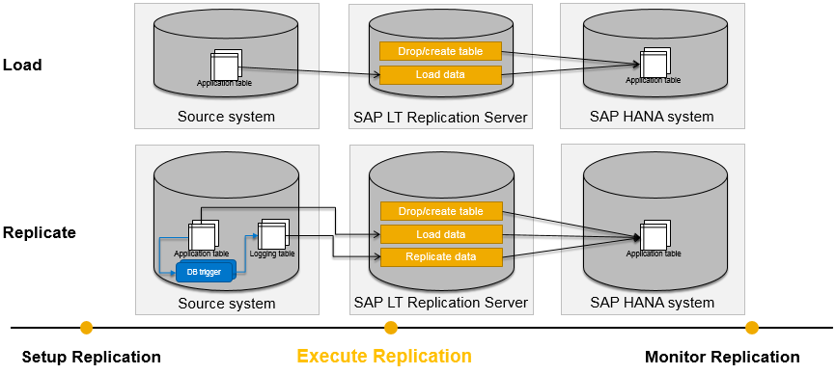
Execute Replication – Load / Replicate
Load: This option is used to load all the data from source to HANA. This is a one-time event, which starts an initial load of data from source system.
Replicate: This option is used to have real-time replication with historical data. It start initial load (if not done earlier), and also consider delta change. Database trigger and related logging table will be created for each table

Slide 15
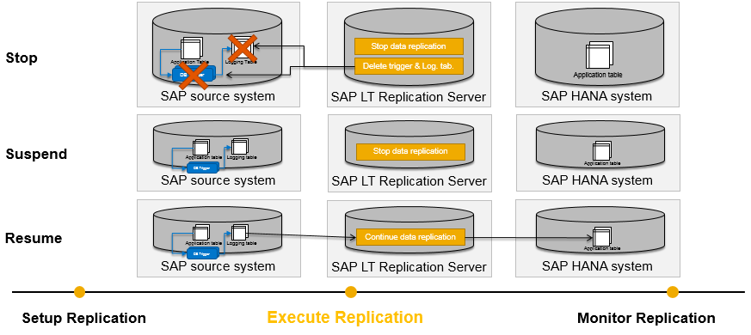
Execute Replication – Stop / Suspend / Resume
Stop Replication: It stops the current replication process for a table. It removes database trigger and logging table completely.
Suspend: It pause a running replication process of a table. The database trigger will not be deleted from the source system, and recording of changes will continue. Related Information is stored in the related logging table in the source system.
Resume: Resume restarts the replication for a suspended table. After resume, the suspended replication process will resume

Slide 16
SLT Replication Server Jobs
Master Job (Monitoring Job)
There is only one master job which handles all active configurations. The decrease and increase of initial load and data transfer jobs is controlled by the composite master job. Naming Convention: /1LT/IUC_REP_MSTR
Every 5 seconds, the monitoring job checks in the SAP HANA system whether there are new tasks and, if so, triggers the master control jobs. It also deletes the processed entries (tasks) from table RS_ORDER and writes statistics entries into table RS_STATUS.
Master Controller Job
Naming Convention: /1LT/IUC_REP_CNTR_<mtid>. This job is scheduled on demand and is responsible creating database triggers and logging table in the source system, Creating synonyms and Writing new entries in admin tables in SLT server when a new table is loaded/replicated
Data Load Job
Naming Convention: 1LT/IUC_LOAD_MT_<mtid>_nnn. This job should always be active. If the job does not complete successfully, the master controller job restarts it. This job is responsible for: Loading data (load), Replicating data (replication).
Access Plan Calculation Job
Naming Convention: /1LT/IUC_CALC_ACP_<mtid>_n. This job calculates the access plan of a specific table (that you choose to load/replicate), and the access plan is used for data load or replication. For a normal sized table, access plan calculation should finish quite quickly (less than 1 minute) while large tables might take up to several hours to finish
Migration Object Definition Job –
Naming Convention: /1LT/IUC_DEF_COBJ_<mtid>. This job defines the migration object of a specific table (that you choose to load/replicate), which is the fundamental object for LT replication. The migration object definition should normally be quite fast for all tables.

Slide 17
Important transactions
LTR – Creation of a new configuration
LTRC – Detailed overview on a configuration
LTRO – Monitoring of several configurations at a glance
LTRS – Advanced replication settings, like transformation rule, tables adjustments or performance
SM37 – Status system jobs
SM21 – System log
SM50 – Work Process Monitor
SM51 – Work Process Monitor including Application Server
SM59 – RFC connection
SE38 -> ADBC_TEST_CONNECTION – DB connection

Slide 18
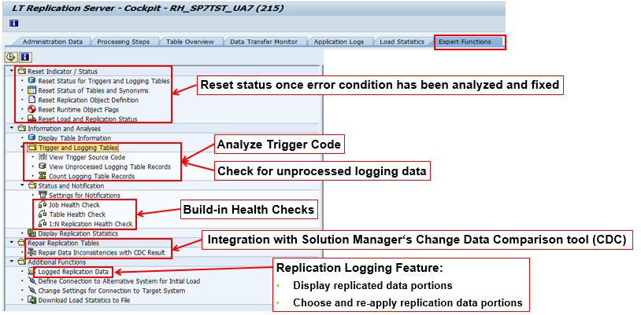
SAP LT Replication Server Cockpit (Transaction LTRC) Expert Functions for Troubleshooting

Slide 19
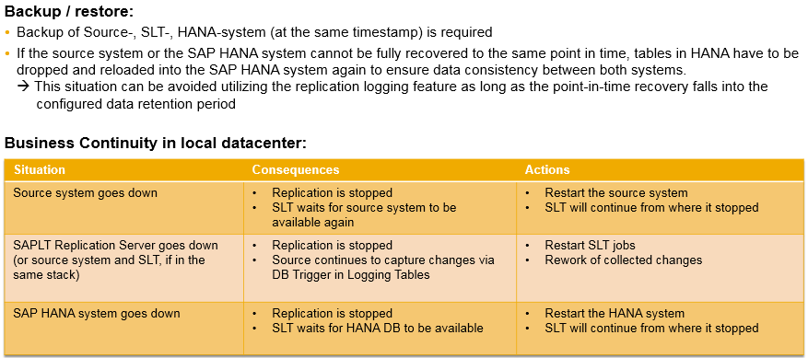
SLT Overview Business Continuity Aspects

